Slide 1

DEPARTMENT OF COMPUTER SCIENCE Project Presentation (KCS 851) (Neural Style Transfer)
Akash Goel(Assistant professor)
Project Members Name with Roll Number & Section
1. Palak Singh (2000290120103)
2. Ragini Rani (2000290120121
3. Kalash Jain (2000290120080)

Slide 2
Problem Statement
The problem we wanted to solve in this project was how to improve the process of transferring the artistic style of one image to the content of another image using neural networks while maintaining the integrity of the content and achieve high quality results.
In other words, the central challenge to be addressed is how to make the neural type conversion process more efficient, productive and user-friendly, ensuring that it produces images that the tone is visually appealing while preserving the important elements of the original content.

Slide 3
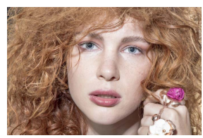
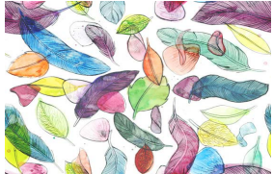
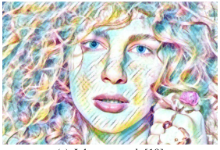
Example of Neural Style Transfer
Content Image
Style Image
Output Image

Slide 4
Objectives
Content Preservation: Ensure that the generated images retain the meaningful content and recognizable objects from the original input images.
Style Replication: Replicate the distinctive artistic styles, including textures, colors, and patterns, from reference images to create visually appealing and stylistically consistent output.

Slide 5
Proposed System
Our proposed system is a web-based platform that leverages neural style transfer technology to allow users to create stylized images. Neural style transfer is a technique that involves applying the artistic style of one image (style image) to the content of another image (content image).
In our system, users will have the ability to upload two images: the content image, which contains the subject matter they want to stylize, and the style image, which defines the artistic style they wish to apply. The system will then use neural network algorithms to blend the content of the input images while preserving the style characteristics, resulting in a stylized output image.

Slide 6
Unique feature
Easy Input: Our system simplifies the stylization process by allowing users to easily upload their content and style images through a user-friendly interface.
Customization: Users have the flexibility to customize their stylized images by adjusting parameters such as style intensity and output resolution. This allows users to fine-tune their images to their preferences.
Fast Processing: The system utilizes cutting-edge neural network algorithms to ensure fast processing times, enabling users to view their stylized images within moments of uploading their input images.
Downloadable Results: Once the stylization process is complete, users can conveniently download their stylized images directly from the website. This makes it easy for users to share their creations or use them in various projects.

Slide 7
Technology Used
Machine Learning Web Application Development with Neural Style Transfer (NST)
This category encapsulates the essence of our project, highlighting the integration of machine learning, specifically neural style transfer, into a web application. Here's a breakdown:
Machine Learning: Our project involves the utilization of machine learning techniques, particularly neural style transfer, to combine the content of one image with the style of another image. This encompasses the training and deployment of a machine learning model capable of transforming images according to specified artistic styles.
Web Application Development: By utilizing Streamlit, we're developing a web application that provides a user-friendly interface for users to interact with the neural style transfer model. This includes features such as image uploading, style selection, and real-time generation of stylized images. The web application aspect emphasizes accessibility and ease of use for users accessing the functionality through a web browser.

Slide 8
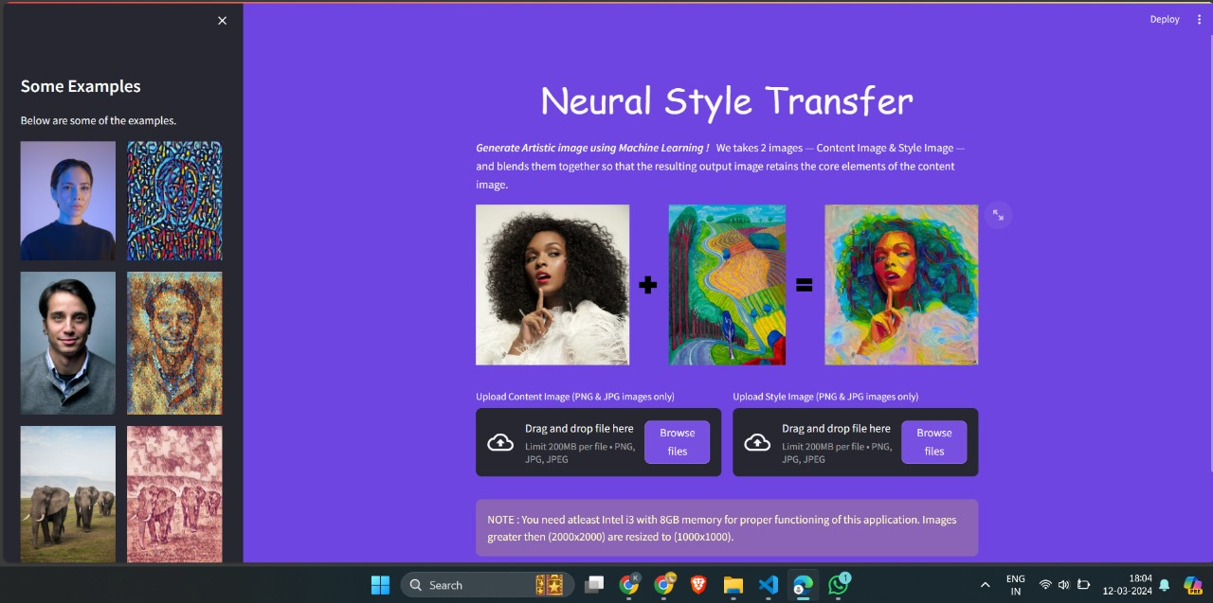
User Interface Representation

Slide 9
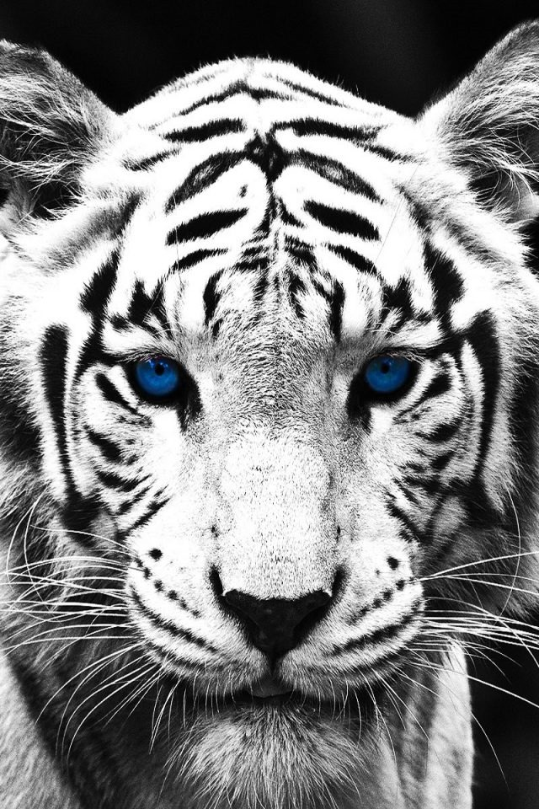
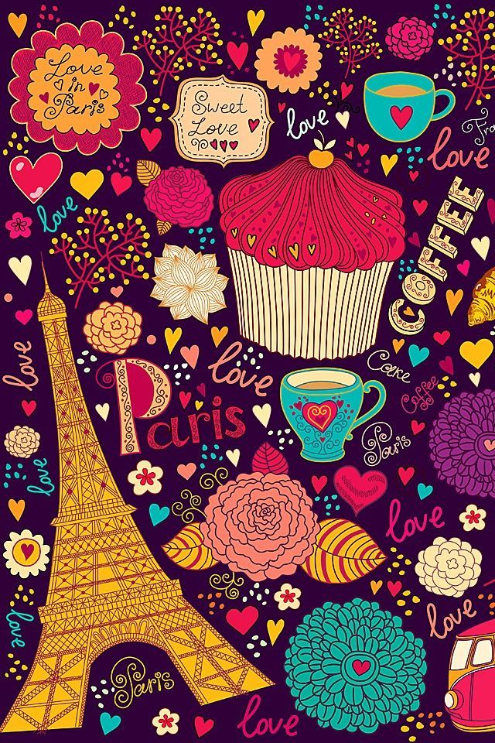
Screenshot of Input images
Content Image Style Image

Slide 10
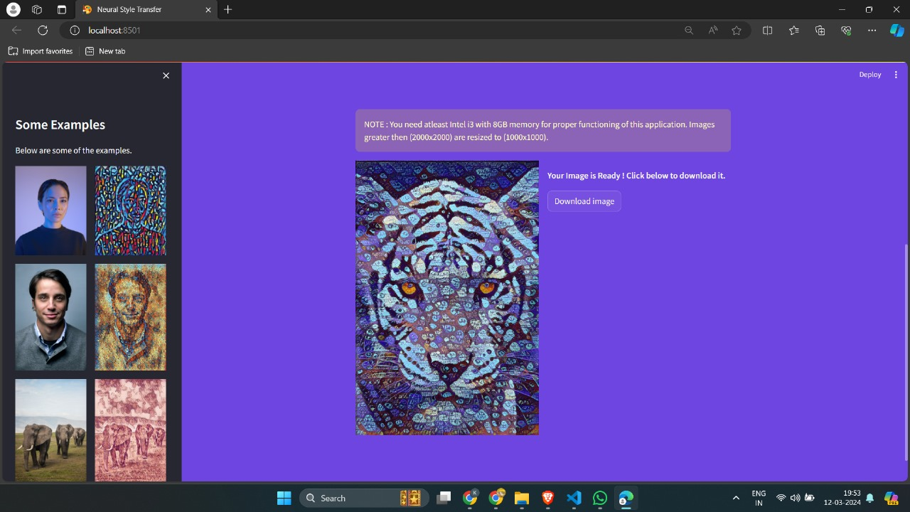
Screenshot of output images

Slide 11
Literature Survey
Sr. No | Reference | Author(s) | Year | Research Focus | Methodology | Key Findings
1. | Wei and Levoy, 2000 | L.-Y. Wei, M. Levoy | 2000 | Fast Texture Synthesis using Tree Structured VQ | Tree Structured Vector Quantization (VQ) | Proposed a fast texture synthesis algorithm using tree structured VQ
2. | Mahendran and Vedaldi, 2014 | A. Mahendran, A. Vedaldi | 2014 | Understanding Deep Image Representations by Inverting | Convolutional Neural Networks (CNNs) | Explored the inversion of deep image representations for understanding
3. | Simonyan and Zisserman, 2014 | Karen Simonyan, Andrew Zisserman | 2014 | Very Deep Convolutional Networks for Image Recognition | Deep Convolutional Networks | Introduced a deep architecture for large-scale image recognition
4. | Yang et al., 2014 | C.-Y. Yang, C. Ma, M.-H. Yang | 2014 | Single-Image Super-Resolution: A Benchmark | Super-Resolution Algorithms | Established a benchmark for single-image super-resolution algorithms
5. | Liu et al., 2015 | F. Liu, C. Shen, G. Lin | 2015 | Deep Convolutional Neural Fields for Depth Estimation | Deep Convolutional Neural Networks (CNNs) | Proposed deep CNNs for depth estimation from a single image

Slide 12
Sr. No | Reference | Author(s) | Year | Research Focus | Methodology | Key Findings
6. | Gatys et al., 2016 | L. A. Gatys, A. S. Ecker, M. Bethge | 2016 | Image Style Transfer using CNNs | Convolutional Neural Networks (CNNs) | Developed an approach for artistic style transfer using CNNs
7. | Johnson et al., 2016 | J. Johnson, A. Alahi, L. Fei-Fei | 2016 | Perceptual Losses for Real-Time Style Transfer | Convolutional Neural Networks (CNNs) | Introduced perceptual loss for real-time style transfer and super-resolution
8. | Dosovitskiy and Brox, 2016 | Alexey Dosovitskiy, Thomas Brox | 2016 | Generating Images with Perceptual Similarity Metrics | Deep Networks, Perceptual Metrics | Proposed a method for image generation based on perceptual similarity metrics
9. | Li and Wand, 2016 | C. Li, M. Wand | 2016 | Precomputed Real-time Texture Synthesis with M-GANs | Markovian Generative Adversarial Networks (M-GANs) | Introduced precomputed real-time texture synthesis using M-GANs
10. | Huang and Belongie, 2017 | X. Huang, S. Belongie | 2017 | Arbitrary Style Transfer in Real-Time | Adaptive Instance Normalization (AdaIN) | Achieved real-time arbitrary style transfer with adaptive normalization

Slide 13
Sr. No. | Reference | Author(s) | Year | Research Focus | Methodology | Key Findings
11. | Elad and Milanfar, 2017 | Michael Elad, Peyman Milanfar | 2017 | Style Transfer via Texture Synthesis | Image Texture Synthesis | Explored style transfer through texture synthesis, achieving realistic results
12. | Hou et al., 2017 | Q. Hou, M.-M. Cheng, X. Hu, A. Borji, Z. Tu, P. Torr | 2017 | Deeply Supervised Salient Object Detection with Short Connections | Deep Learning, Short Connections | Proposed a deeply supervised approach for salient object detection with short connections
13. | Jing et al., 2020 | Y. Jing, Y. Yang, Z. Feng, J. Ye, Y. Yu, M. Song | 2020 | Neural Style Transfer: A Review | Neural Style Transfer Techniques | Presented a comprehensive review of neural style transfer methods
14. | Khatter et al., 2021 | H. Khatter, S. Arif, U. Singh, S. Mathur, S. Jain | 2021 | Product Recommendation System for E-Commerce using Collaborative Filtering | Collaborative Filtering, Textual Clustering | Developed a recommendation system integrating collaborative filtering and textual clustering for E-Commerce
15. | Sharma et al., 2022 | S. Sharma, S. Gupta, D. Gupta, S. Juneja, G. Singal, G. Dhiman, S. Kautish | 2022 | Recognition of Gurmukhi Handwritten City Names Using Deep Learning | Deep Learning, Cloud Computing | Implemented a system for recognizing handwritten Gurmukhi city names using deep learning and cloud computing

Slide 14
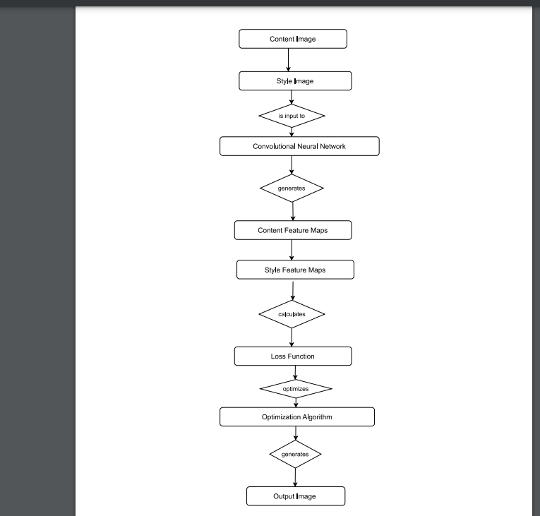
Workflow Diagram

Slide 15
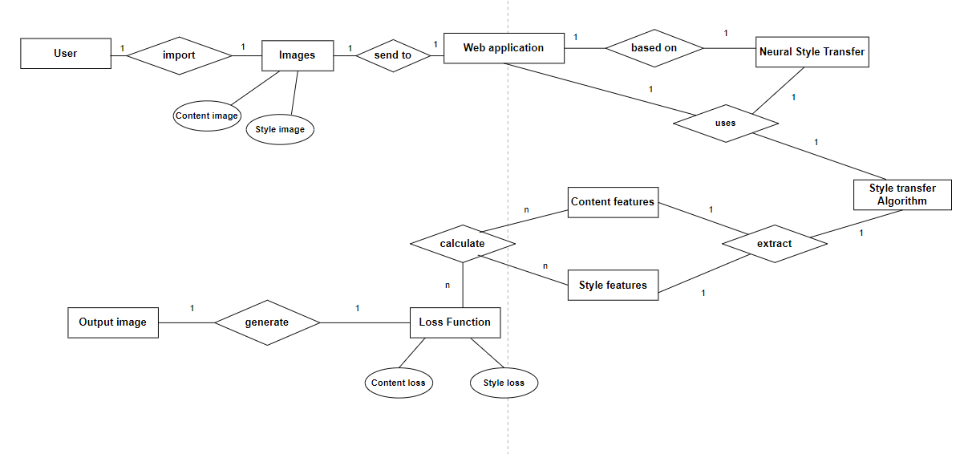
ER Diagram

Slide 16
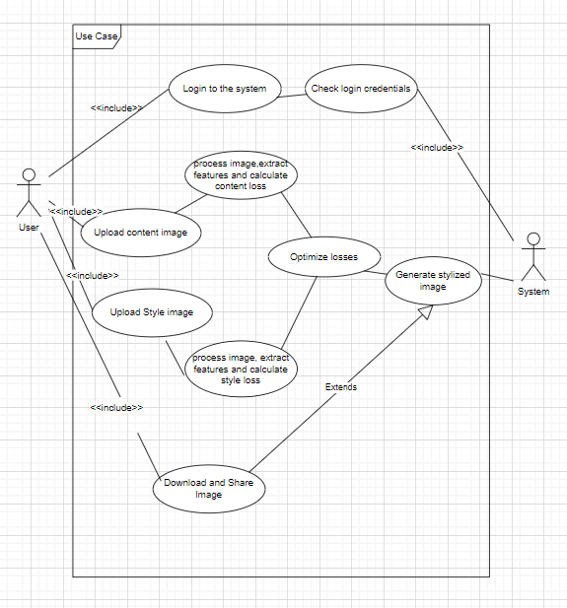
Use Case Diagram

Slide 17
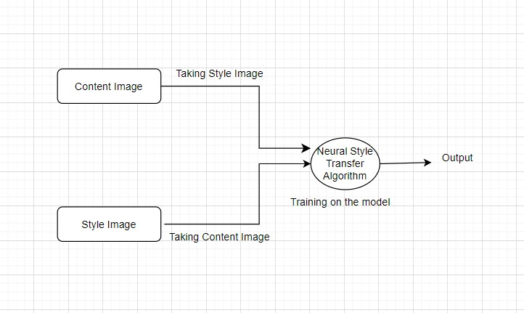
Data Flow Diagram
Level-0 DFD

Slide 18
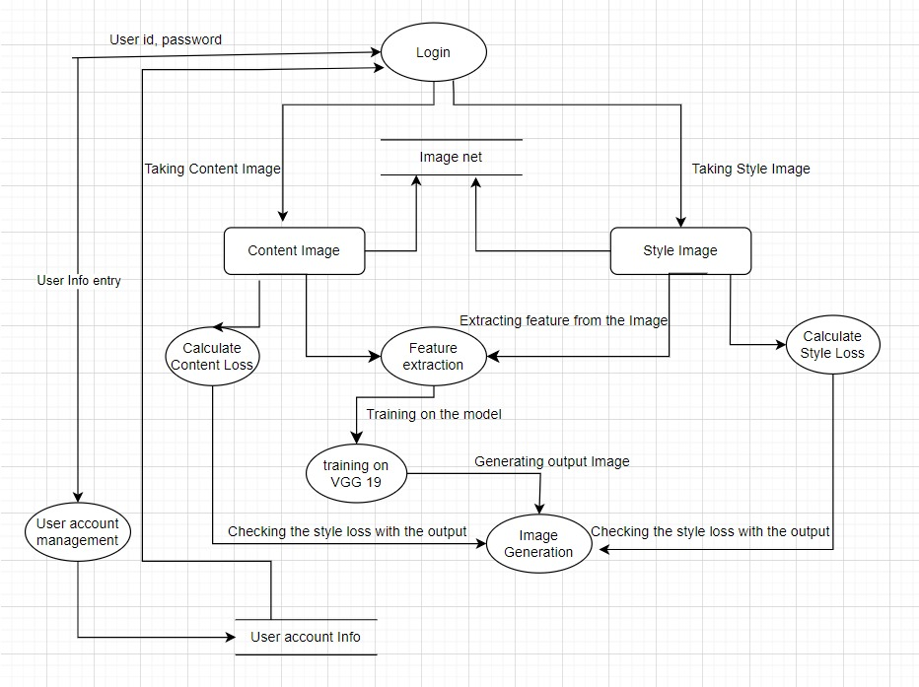
Level-1 DFD

Slide 19
Patent Status
Patent published
https://drive.google.com/file/d/18TR2ZxfHf39B-MSftPo__pneiNZ2Ohoy/view?usp=sharing

Slide 20
Research Paper Status
Research paper published
Link-
https://drive.google.com/file/d/1olWJ1HKpYSQQhiFtCI8-0e9XLmTk9J_1/view?usp=sharing

Slide 21
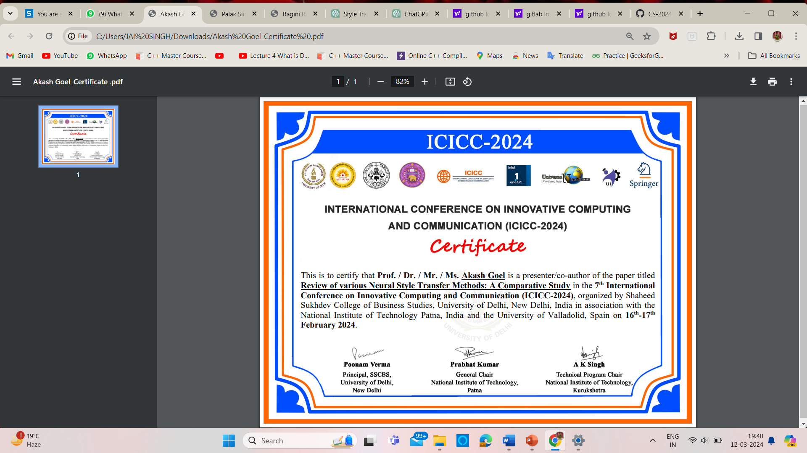
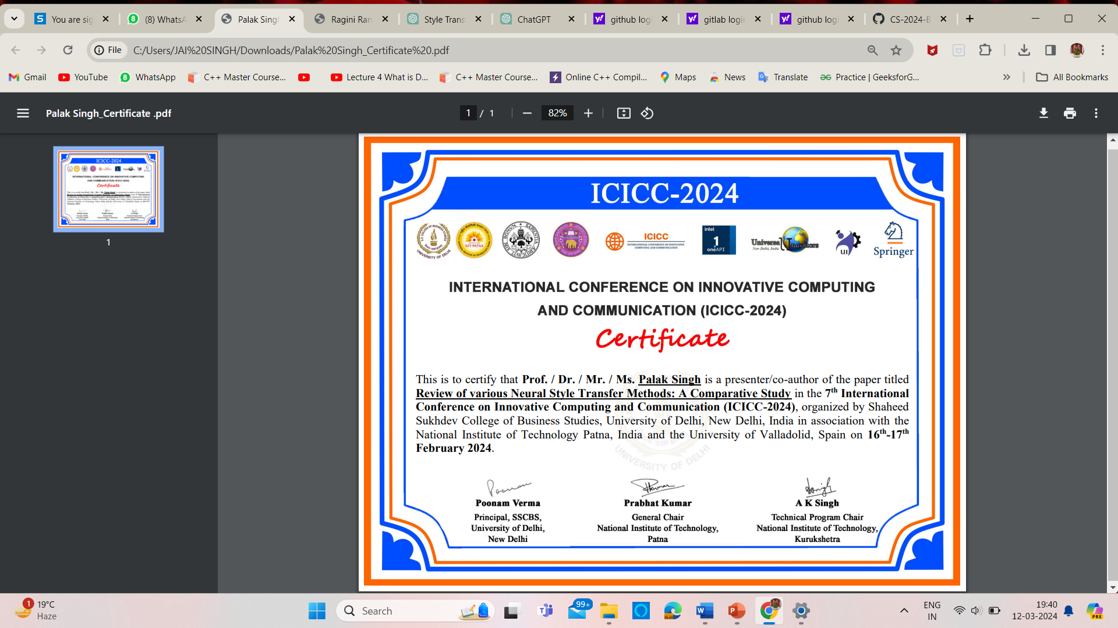
Certificate

Slide 22
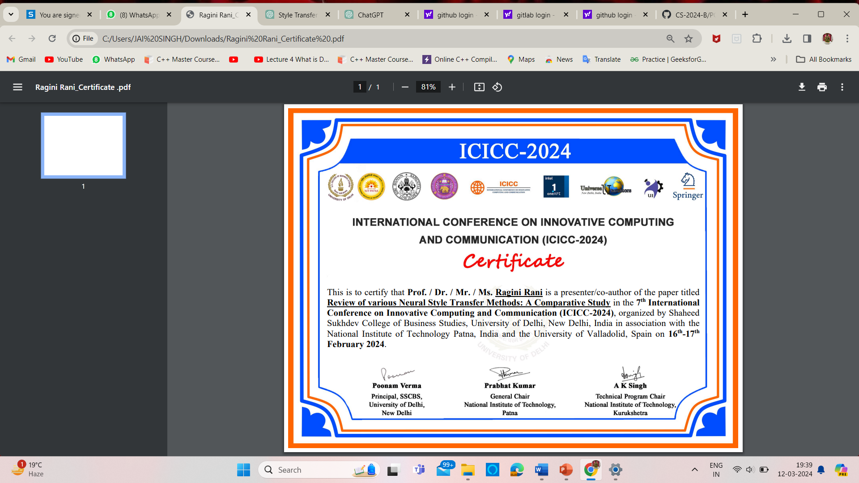
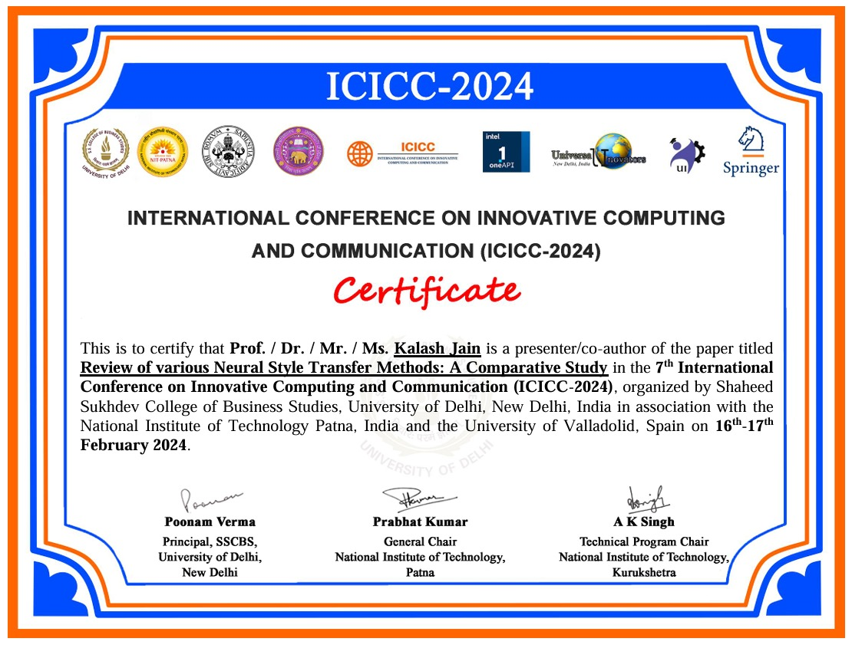

Slide 23
Project Status
Project Completed
GitHub Link- https://github.com/KIET-Github/CS-2024-B/tree/main/PCS24-53-KalashJain

Slide 24
All documents Proofs
Hyperlink of the testing report
https://drive.google.com/file/d/10s8-MbL6PhzEKAsGZe2Obe7xANAqQdld/view?usp=sharing
Hyperlink of the Synopsis
https://drive.google.com/file/d/1U3KYWc8SPYtyZ8DzBaL4GbK-cXZBksQM/view?usp=sharing
Hyperlink of the SRS
https://drive.google.com/file/d/1YhWDtbD_8_MZc3wpeVgUpY-YA1-H--ex/view?usp=sharing
Hyperlink of Report.
https://drive.google.com/file/d/1AkrfUXkwkB7EcDPS4-Te2rHxp9-ub5Im/view?usp=sharing

Slide 25
References
[1] Gatys, L. A., Ecker, A. S., Bethge, M. (2016). "Image Style Transfer using CNNs." In IEEE Conference on Computer Vision and Pattern Recognition (CVPR), 2016.
[2] Huang, X., Belongie, S. (2017). "Arbitrary Style Transfer in Real-Time with Adaptive Instance Normalization." In IEEE International Conference on Computer Vision (ICCV), 2017.
[3] Johnson, J., Alahi, A., Fei-Fei, L. (2016). "Perceptual Losses for Real-Time Style Transfer and Super-Resolution." In European Conference on Computer Vision, 2016.
[4] Wei, L.-Y., Levoy, M. (2000). "Fast Texture Synthesis using Tree Structured Vector Quantization." In Proceedings of the 27th Annual Conference on Computer Graphics and Interactive Techniques, 2000.
[5] Elad, M., Milanfar, P. (2017). "Style Transfer via Texture Synthesis." In IEEE Transactions on Image Processing, 2017.
[6] Simonyan, K., Zisserman, A. (2014). "Very Deep Convolutional Networks for Large-Scale Image Recognition." In International Conference on Learning Representation, 2014.
[7] Dosovitskiy, A., Brox, T. (2016). "Generating Images with Perceptual Similarity Metrics." In IEEE Conference on Computer Vision and Pattern Recognition (CVPR), 2016.

Slide 26
[8] Khatter, H., Arif, S., Singh, U., Mathur, S., Jain, S. (2021). "Product Recommendation System for E-Commerce using Collaborative Filtering and Textual Clustering." In Third International Conference on Inventive Research in Computing Applications (ICIRCA), 2021.
[9] Sharma, S., Gupta, S., Gupta, D., Ju neja, S., Singal, G., Dhiman, G., Kautish, S. (2022). "Recognition of Gurmukhi Handwritten City Names Using Deep Learning." In Hindawi Limited, 2022.
[10] Mahendran, A., Vedaldi, A. (2014). "Understanding Deep Image Representations by Inverting." CVPR, 2014.
[11] Liu, F., Shen, C., Lin, G. (2015). "Deep Convolutional Neural Fields for Depth Estimation from a Single Image." In CVPR, 2015.
[12] Li, C., Wand, M. (2016). "Precomputed Real-time Texture Synthesis with Markovian Generative Adversarial Networks." In European Conference on Computer Vision, 2016.
[13] Yang, C.-Y., Ma, C., Yang, M.-H. (2014). "Single-Image Super-Resolution: A Benchmark." In European Conference on Computer Vision, 2014.
[14] Jing, Y., Yang, Y., Feng, Z., Ye, J., Yu, Y., Song, M. (2020). "Neural Style Transfer: A Review." In IEEE Transactions on Visualization and Computer Graphics, 26(11), 3365-3385, 2020.
[15] Hou, Q., Cheng, M.-M., Hu, X., Borji, A., Tu, Z., Torr, P. (2017). "Deeply Supervised Salient Object Detection with Short Connections." In IEEE Conference on Computer Vision and Pattern Recognition (CVPR), 2017.

